Slide 1

DNA Sequencing
Algoritmos Avançados de Bioinformática

Slide 2
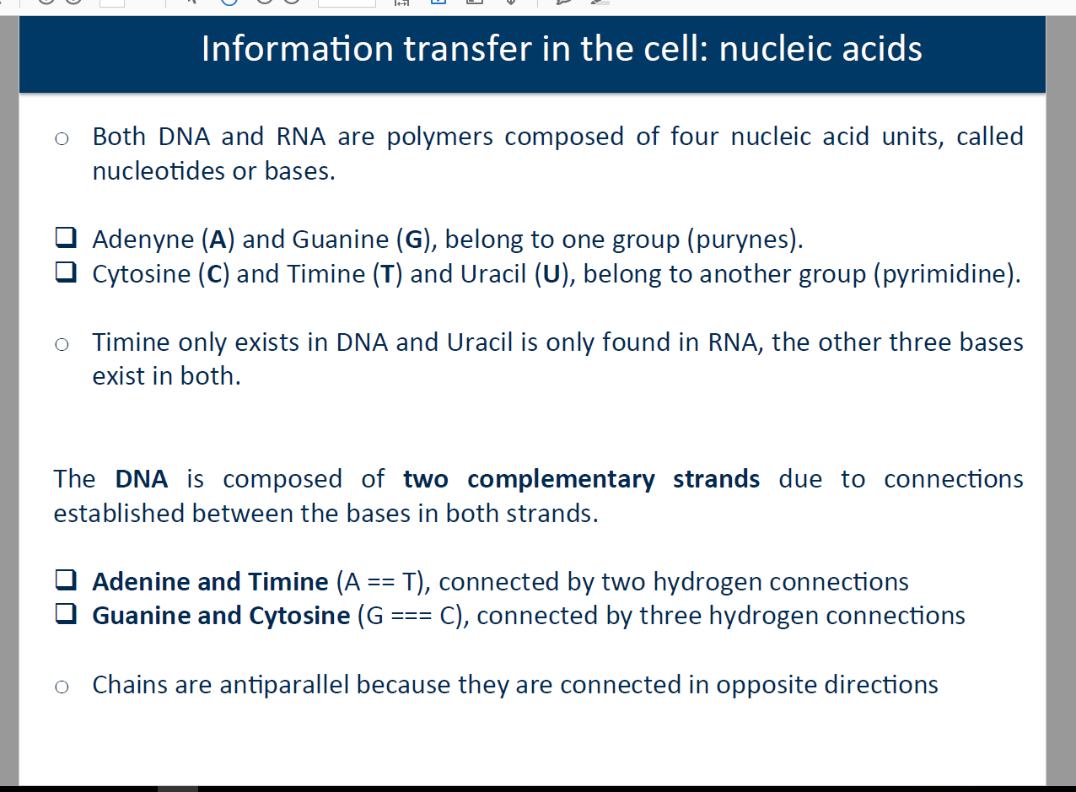
Sequencing Technologies

Slide 3

Sequencing Technologies

Slide 4
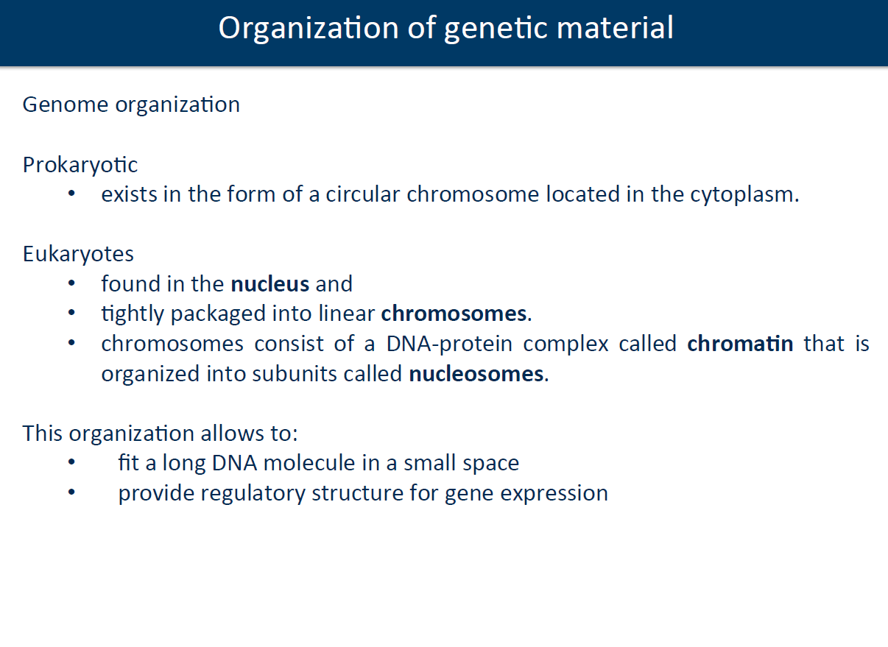
Sequencing Technologies

Slide 5
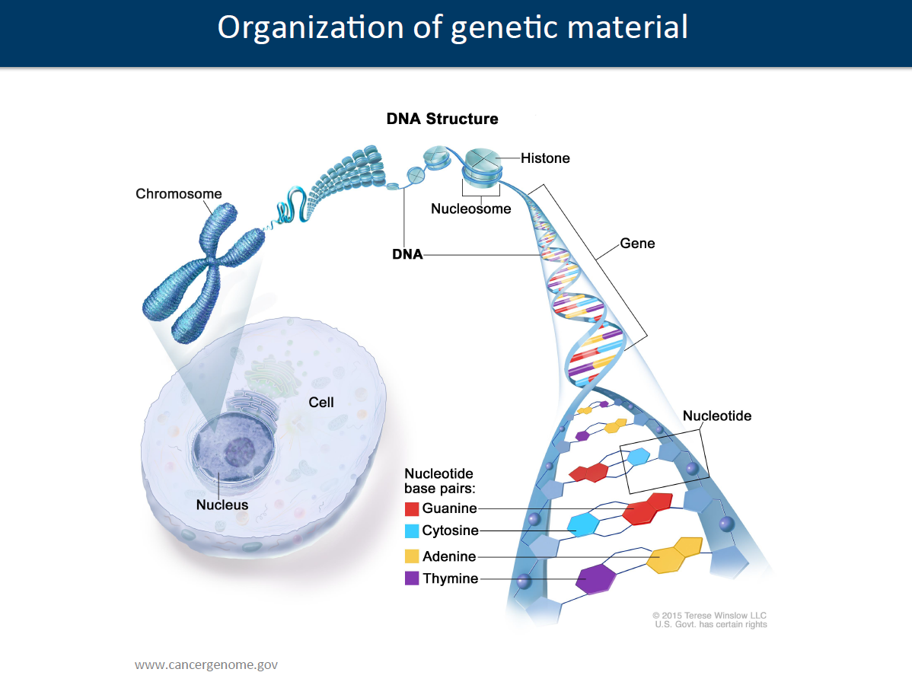
Sequencing Technologies

Slide 6
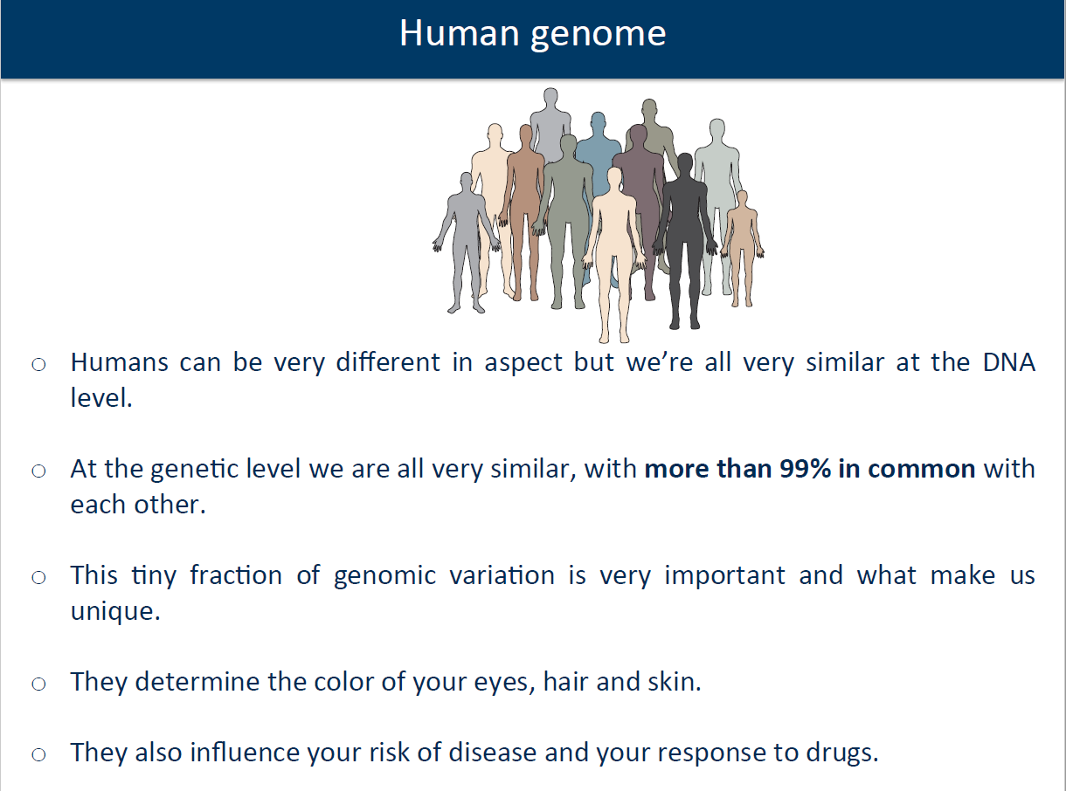
Sequencing Technologies

Slide 7
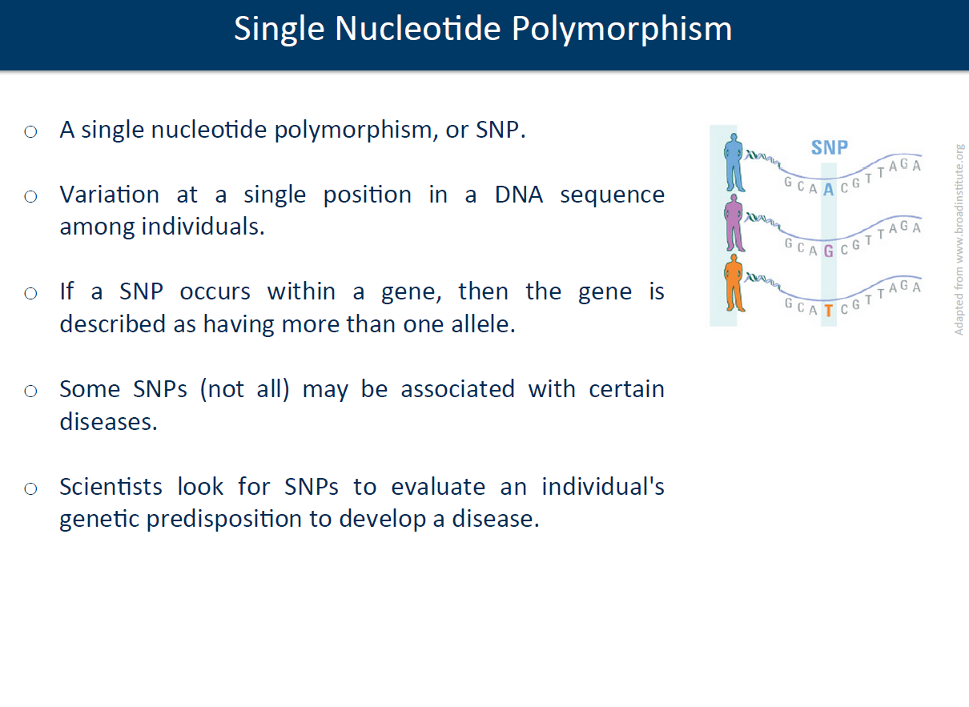
Sequencing Technologies

Slide 8
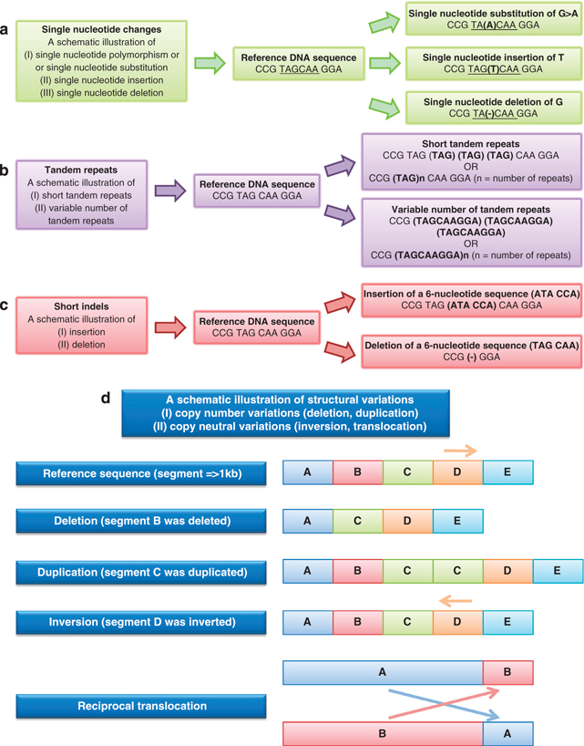
SNP Single Nucleotide Changes
Adapted from C.Ku et al, “ the discovery of human genetic variations and their use as disease
markers: past, present and future” Journal of Human Genetics, 2017

Slide 9
Tandem Repeats
Adapted from C.Ku et al, “ the discovery of human genetic variations and their use as disease
markers: past, present and future” Journal of Human Genetics, 2017

Slide 10
Short indels
Adapted from C.Ku et al, “ the discovery of human genetic variations and their use as disease
markers: past, present and future” Journal of Human Genetics, 2017

Slide 11
Variations
Adapted from C.Ku et al, “ the discovery of human genetic variations and their use as disease
markers: past, present and future” Journal of Human Genetics, 2017

Slide 12


Slide 13
Sequencing Technologies
Typical applications of massive (also called next-generation) sequencing technologies:
DNA Sequencing
De novo Genome Assembly
Single Nucleotide Variation discovery
Copy Number Variation detection
Structural Rearrangements

Slide 14
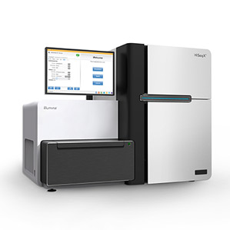


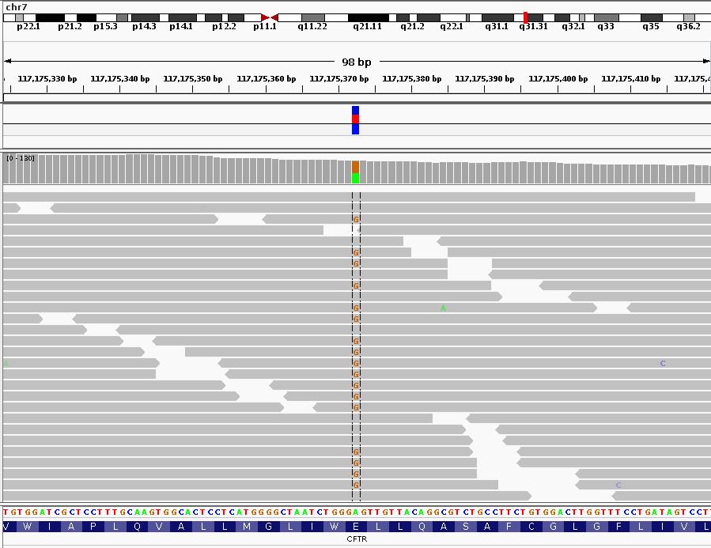
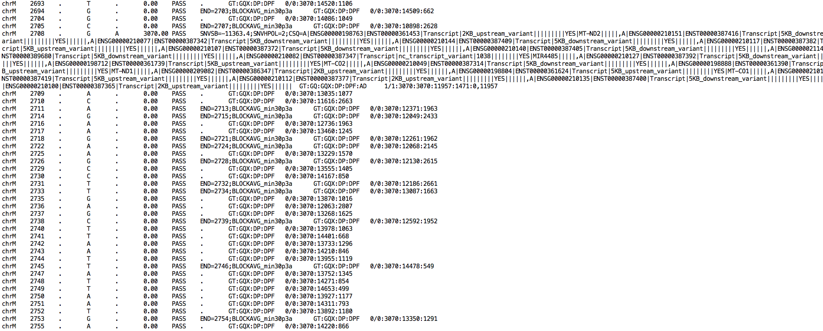

Variant Calling Analysis Pipeline
Tissue
collection
Sample
preparation
Variant
Calling
Sequencing
Mapping
~ 1 day
~ 1/2 days
~ 2/5 days
~ 2 days
Several weeks

Slide 15
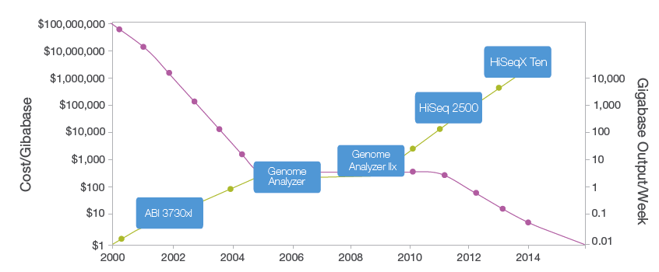
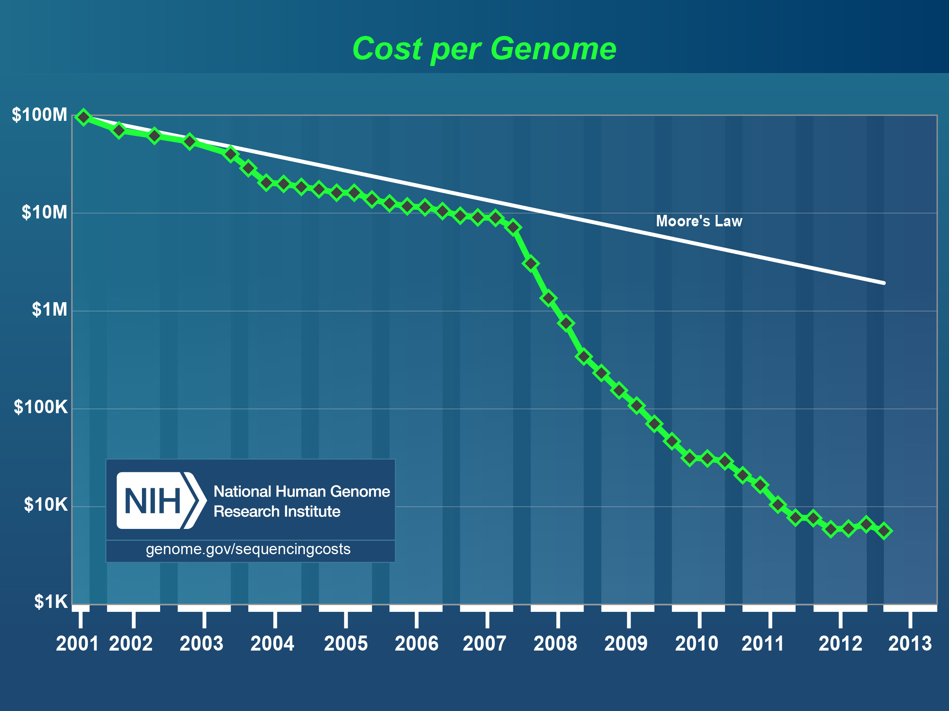
Sequencing Cost and Data Output
Cost and Ouput of Ilumina sequencing machines across the years

Slide 16
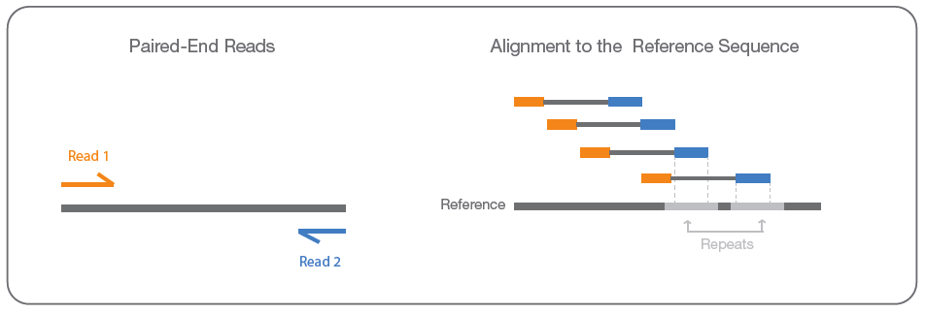
Sequence Reads (Concepts)
Insert – the DNA fragment that is used for sequencing.
Read – the part of the insert that is sequenced.
Single Read (SR) – a sequencing procedure by which the insert is sequenced from one end only.
Paired End (PE) – a sequencing procedure by which the insert is sequenced from both ends.
Insert size - average distance between read pair mates
Read 1
Read 2
insert
Adapted from Illumina.com

Slide 17
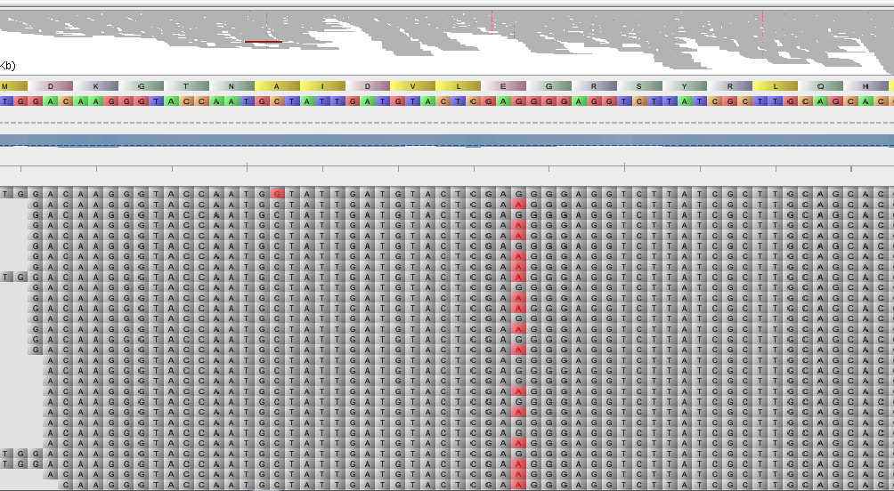
Next Generation Sequencing File Formats
Algoritmos Avançados de Bioinformática

Slide 18
File Naming Convention
Certain programs have strict naming conventions and besides the data format they use information in the filename to interpret aspects of the data.
File naming conventions make easier the managing of the files.
Typically a suffix is used to denote the data type.
Full description of several data formats can be found here:
https://genome.ucsc.edu/FAQ/FAQformat.html#format5.1
Most common file formats for next-generation sequencing data:
FASTA, FASTQ, SAM/BAM
other common formats:
BED, WIG, GFF/GTF, VCF

Slide 19
FASTA
FASTA (.fasta, .fa, .fsa)
Possibly the most common biological sequence format. It may contain nucleotide or peptide sequence(s) and a single-line header per sequence.
It contains a header line that starts with ">" followed by the sequenced identifier and description. The next lines contain the sequence.
Format:
Line 1: Single line description, marked by “>”
Line 2…n: Lines of sequence data (no longer than 60 characters)
$ cd Motifs
$ head tf4.fasta.txt
>gi|557079417|gb|ESQ25234.1| Transcription initiation factor TFIIIB, Brf1 subunit/Transcription initiation factor TFIIB [uncultured Acidilobus sp. OSP8]
MRCPVCGSARLAWDGSTGYLVCQDCGAVISQLIEEERPALPRPPWRPIRRRPEPVVPPASRPLEEDVEEAAAKAVRRGRV
IEIVGRAVRLRPPMKEKVEGLEGLLEMMSGFPDLKSRTERVRKALALYAALRAMGLSRSRATELASRATGASPRSILKVR
ERHQRSLDMYEVAVAEALRQKRLSPPMLAEKLKAGLGPSVHS

Slide 20
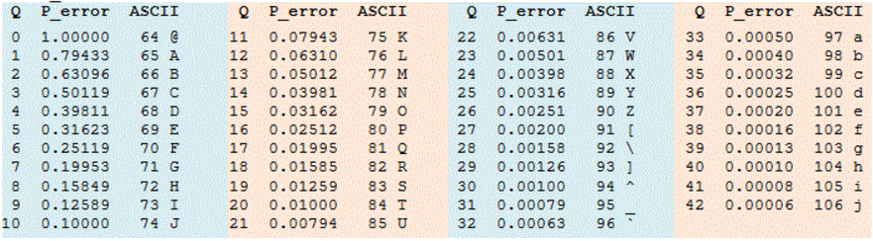
FASTQ
$ cd NGS
$ head top_1.fq
Sequence identifier
@K00136:112:H3LFLBBXX:5:1102:32191:34473 1:N:0
TGCCAGGGCCCCTGCCTGTGGGACTCCACCCAAAGCAGGTTCACACCAGGACACACCTGGCACCTTTGGCATTGCCTCCCTGTGCCCTAAGCAATCTCCC
+
```eejje[eejjjjjjjjjjjjjjjjjjjjjjjjjjjjjjjjjjjejjjj`jjjjj`jjejjjjjjjjjjjjjjjjjjjjjjejjjjj`ejj``jjjej
Sequence
Quality Score
For each base pair sequence there is an associated quality score;
This corresponds to an integer value that represents the probability of an error;
The score is known as Phred or Q score;
Each value is encoded as a ASCII character;
Q = –10 log10(P)
Adapted from http://drive5.com/usearch/manual/quality_score.html

Slide 21
Quality Control of FASTQ files
Use fastQC for QC statistics and a quick graphical overview of the dataset.
# uncompress the assembly taster file
$ tar –xvf assembly_taster.tar.xz
$ cd assembly_taster/
# Run FastQC on the dataset
$ fastqc mt_reads.fastq
# change to mt_reads_fastqc folder
# open report.html in browser by double clicking

Slide 22
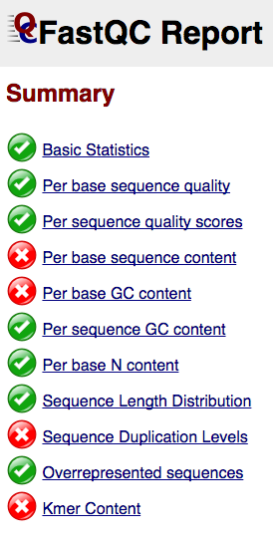
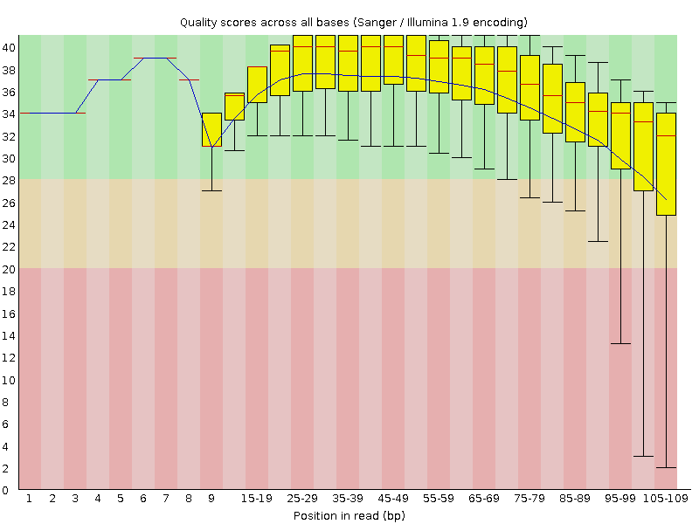
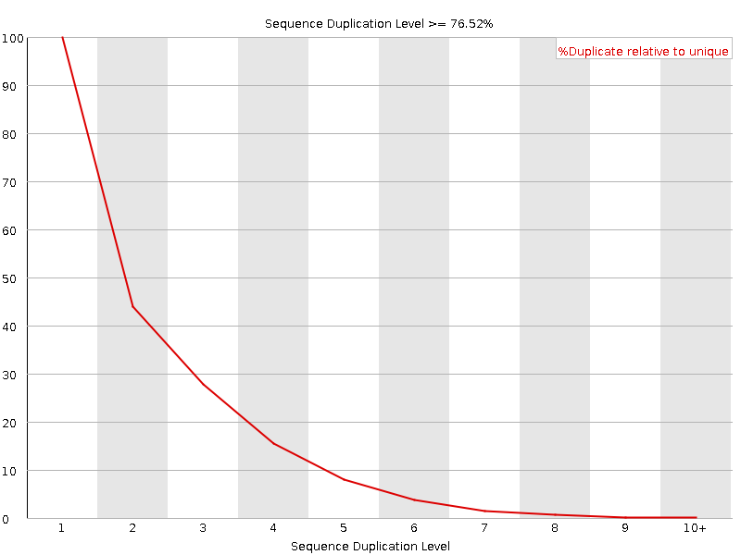
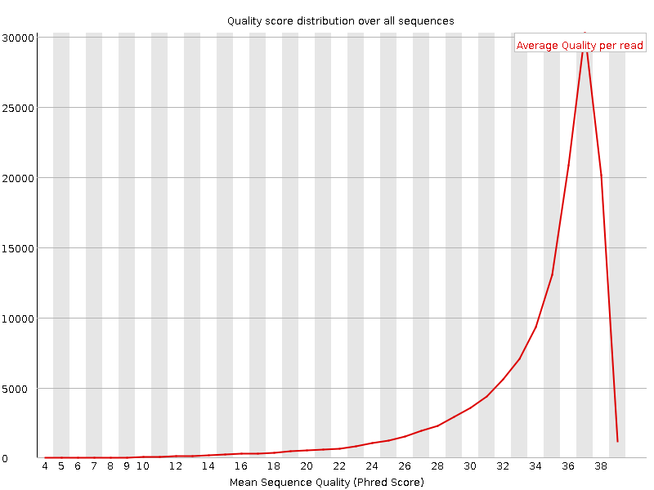
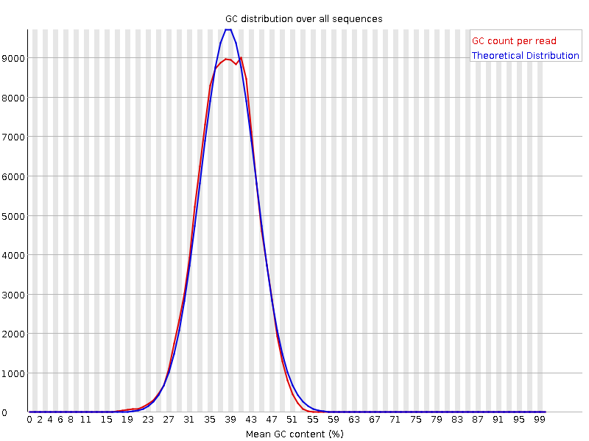
Quality Control of FASTQ files

Slide 23
SAM/BAM
Sequence Alignment/Map SAM/BAM (.sam, .bam) is a tab-delimited file format. SAM files contain detailed and rich mapping information of the reads against the reference genome/sequence. SAM is a text format and BAM is a binary version of SAM for efficient indexing.
It contains an header lines with meta information that start with the ‘@’ symbol. Each alignment line consists of following fields:
Format:
QNAME Query template/pair NAME
FLAG bitwise FLAG
RNAME Reference sequence NAME
POS 1-based leftmost POSition/coordinate of clipped sequence
MAPQ MAPping Quality (Phred-scaled)
CIGAR extended CIGAR string
MRNM Mate Reference sequence NaMe (‘=’ if same as RNAME)
MPOS 1-based Mate POSistion
LEN inferred Template LENgth (insert size)
SEQ query SEQuence on the same strand as the reference
QUAL query QUALity (ASCII-33 gives the Phred base quality)
OPT variable OPTional fields in the format TAG:VTYPE:VALUE

Slide 24
SAM/BAM
Samtools is a package of tools to efficiently manipulate SAM and BAM files.
Usage: samtools <command> [options]
Command: view SAM<->BAM conversion
sort sort alignment file
mpileup multi-way pileup
depth compute the depth
faidx index/extract FASTA
tview text alignment viewer
index index alignment
idxstats BAM index stats (r595 or later)
fixmate fix mate information
flagstat simple stats
calmd recalculate MD/NM tags and '=' bases
merge merge sorted alignments
rmdup remove PCR duplicates
reheader replace BAM header
cat concatenate BAMs
bedcov read depth per BED region
targetcut cut fosmid regions (for fosmid pool only)
phase phase heterozygotes
bamshuf shuffle and group alignments by name

Slide 25
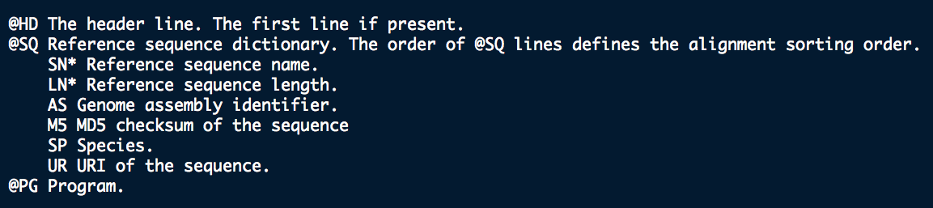
SAM/BAM
SAM files have an header (optional) that provide metadata about the alignment.

Slide 26
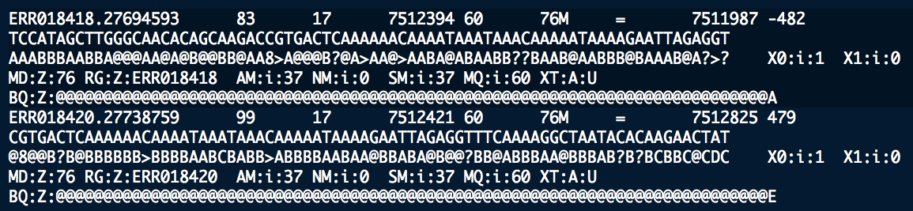
SAM/BAM
Samtools is a package of tools to efficiently manipulate SAM and BAM files.
$ samtools view -h ftp://ftp.1000genomes.ebi.ac.uk/vol1/ftp/phase1/data/HG00154/alignment/HG00154.mapped.ILLUMINA.bwa.GBR.low_coverage.20101123.bam 17:7512445-7513455 > example.sam
$ less example.sam
Each row defines a single raw read alignment against the reference genome.
For further details:
"The Sequence Alignment/Map format and SAMtools", Heng Li et al, Bioinformatics 2009.

Slide 27
SAM/BAM
FLAG Combination of bitwise FLAGs
MAPQ (mapping quality - describes the uniqueness of the alignment, 0=non-unique, >10 probably unique)
Read id
chromosome
position
SOLEXA-1GA-2_2_FC20EMB:5:159:128:412 0 chr1 911324 25 36M * 0 0 CCCTCCACCCACCCAGACTTTAGCACCTCCCTCCCA feeh_cQ_T`[YZTJSGLJTNGMFIFKGH@BAFGE? NM:i:0 X0:i:1 MD:Z:36
Quality
sequence
Template length
Program specific Flags
Position of mate (mate pair information)
Name of mate (mate pair information for paired-end sequencing, often "=")
CIGAR string (describes the position of insertions/deletions/matches in the alignment, encodes splice junctions, for example)

Slide 28
SAM/BAM
Manipulate a BAM file, by extracting some alignments from it and create a new BAM file.
Get an example RNA-seq BAM file from ENCODE project.
$ wget http://hgdownload.cse.ucsc.edu/goldenPath/hg19/encodeDCC/wgEncodeUwRepliSeq/wgEncodeUwRepliSeqBg02esG1bAlnRep1.bam
$ samtools view -h wgEncodeUwRepliSeqBg02esG1bAlnRep1.bam | head -1000 > top.sam
$ samtools view -b top.sam > top.bam

Slide 29
BED
BED (Browser Extensible Data) is flexible data format that defines the genomic coordinates of defined features (exons, genes, ESTs, ...). Each line defines the coordinates of the feature and there are three required fields (BED3) and nine additional optional fields. The number of fields per line must be consistent throughout the file.
The first three required BED fields are:
chrom - The name of the chromosome (e.g. chr3, chrY, chr2_random).
chromStart - The starting position of the feature in the chromosome.
chromEnd - The ending position of the feature in the chromosome.
Other three common fields:
4. name - Defines the name of the feature.
5. score - A score between 0 and 1000 for coloring purposes.
6. strand - Defines the strand - either '+' or '-'.
$ cd GenomeAnnotation
$ head gene.regions.bed
# Another example file
track name=pairedReads description="Clone Paired Reads" useScore=1
chr22 1000 5000 cloneA 960 + 1000 5000 0 2 567,488, 0,3512
chr22 2000 6000 cloneB 900 - 2000 6000 0 2 433,399, 0,3601

Slide 30
WIG
Wiggle format (WIG) allows the display of continuous-valued data in a track format. Wiggle format is line-oriented. It defines genomic intervals/regions with an associated value to be plotted.
There are two options for formatting wiggle data: variableStep and fixedStep.
# variableStep is for data with irregular intervals between new data points.
# Example
variableStep chrom=chr2
300701 12.5
300801 15.0
300903 10.5
300940 8.9
# fixedStep is for data with regular intervals between new data values and is the more compact wiggle format.
# Example
fixedStep chrom=chr3 start=400601 step=100
11
22
33

Slide 31
GFF/GTF
GFF (General Feature Format) is a format used to describe gene structure annotation. GFF lines have nine required fields that must be tab-separated.
Format:
seqname - The name of the sequence. Must be a chromosome or scaffold.
source - The program that generated this feature.
feature - The name of this type of feature. Some examples of standard feature types are "CDS", "start_codon", "stop_codon", and "exon".
start - The starting position of the feature in the sequence. The first base is numbered 1.
end - The ending position of the feature (inclusive).
score - A score between 0 and 1000. If the track line useScore attribute is set to 1 for this annotation data set, the score value will determine the level of gray in which this feature is displayed (higher numbers = darker gray). If there is no score value, enter ".".
strand - Valid entries include '+', '-', or '.' (for don't know/don't care).
frame - If the feature is a coding exon, frame should be a number between 0-2 that represents the reading frame of the first base. If the feature is not a coding exon, the value should be '.'.
group - All lines with the same group are linked together into a single item.

Slide 32
GFF/GTF
GTF (Gene Transfer Format) is a refinement to GFF that tightens the specification. The first eight GTF fields are the same as GFF. The group field has been expanded into a list of attributes.
$ cd GenomeAnnotation
$ gzcat genes.gtf.zip | head
unknown exon 11874 12227 . + . gene_id "LOC100287102"; gene_name "LOC100287102"; p_id "P25115"; transcript_id "XM_002342010.1"; tss_id "TSS26210";
1 unknown CDS 12190 12227 . + 0 gene_id "LOC100287102"; gene_name "LOC100287102"; p_id "P25115"; transcript_id "XM_002342010.1"; tss_id "TSS26210";

Slide 33
VCF
Variant Call Format (VCF) is a flexible and extendable format for variation data such as single nucleotide variants, insertions/deletions, copy number variants and structural variants. This format is defined by the 1000 Genomes consortium: http://www.1000genomes.org/wiki/Analysis/Variant%20Call%20Format/vcf-variant-call-format-version-41 and the GA4GH working group: http://ga4gh.org/#/fileformats-team
There are 8 fixed fields per record. All data lines are tab-delimited.
1. CHROM - chromosome:
2. POS - position: The reference position
3. ID - identifier: Semi-colon separated list of unique identifiers where available. If this is a dbSNP variant it is encouraged to use the rs number(s).
4. REF - reference base(s): Each base must be one of A,C,G,T,N (case insensitive). Multiple bases are permitted.
5. ALT - alternate base(s): Comma separated list of alternate non-reference (A,C,G,T,N,*) alleles called on at least one of the samples.
6. QUAL - quality: Phred-scaled quality score for the assertion made in ALT. i.e. ?10log10 prob(call in ALT is wrong).
7. FILTER - filter status: PASS if this position has passed all filters, i.e. a call is made at this position.
8. INFO - additional information: INFO fields are encoded as a semicolon-separated series of short
keys with optional values in the format: <key>=<data>[,data].

Slide 34
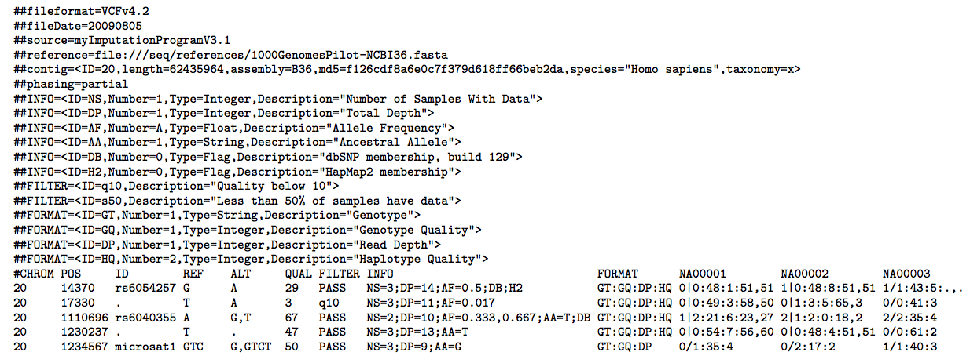
VCF Example
Example of a VCF file. Adapted from the VCF specification document:
http://samtools.github.io/hts-specs/VCFv4.2.pdf

Slide 35
VCF Example
Example files for testing are provided by Illumina. Whole-genome sequencing performed on Illumina HiSeq® systems is enabling researchers worldwide to more fully and accurately characterize the human genome.
Illumina have derived a set of high-confidence variant calls for NA12877 and NA12878 (part of the 1000 Genomes Project). The results of the analysis, VCF files and documentation, can be obtained from here:
ftp://ussd-ftp.illumina.com/
Example vcf file for NA12878:
$ wget ftp://platgene_ro@ussd-ftp.illumina.com/hg19/8.0.1/NA12878/NA12878.vcf.gz

Slide 36
Variant Calling Analysis
Algoritmos Avançados de Bioinformática

Slide 37
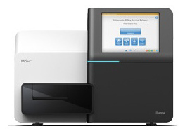
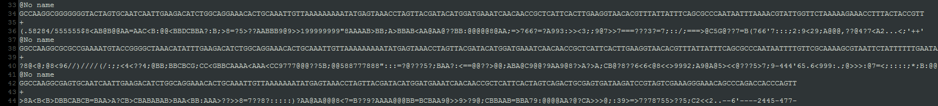
Alignment and Variant Calling (Bioinformatics Analysis)
Fastq file
reference
genome/exome
Ensembl, NCBI, UCSC download
CATTCG
CATTCG
CATTCG
TTCAACATTCGAG
Figure adapted from Patricia Oliveira
Fastq file
CATTCG
Quality
Filtering
CATTCG
TATTCG
TTCAAC
CATTCG
TATTCG
ATTCGA
TTCAAC
TATTCG
Alignment (bwa)
ATTCGA
ATTCGA
TTCAAT
ATTTGA
ATTCGA
READS
HQ READS
2. Variant calling (Samtools)
4 high quality reads in
this position
Matches the
RefSeq

Slide 38
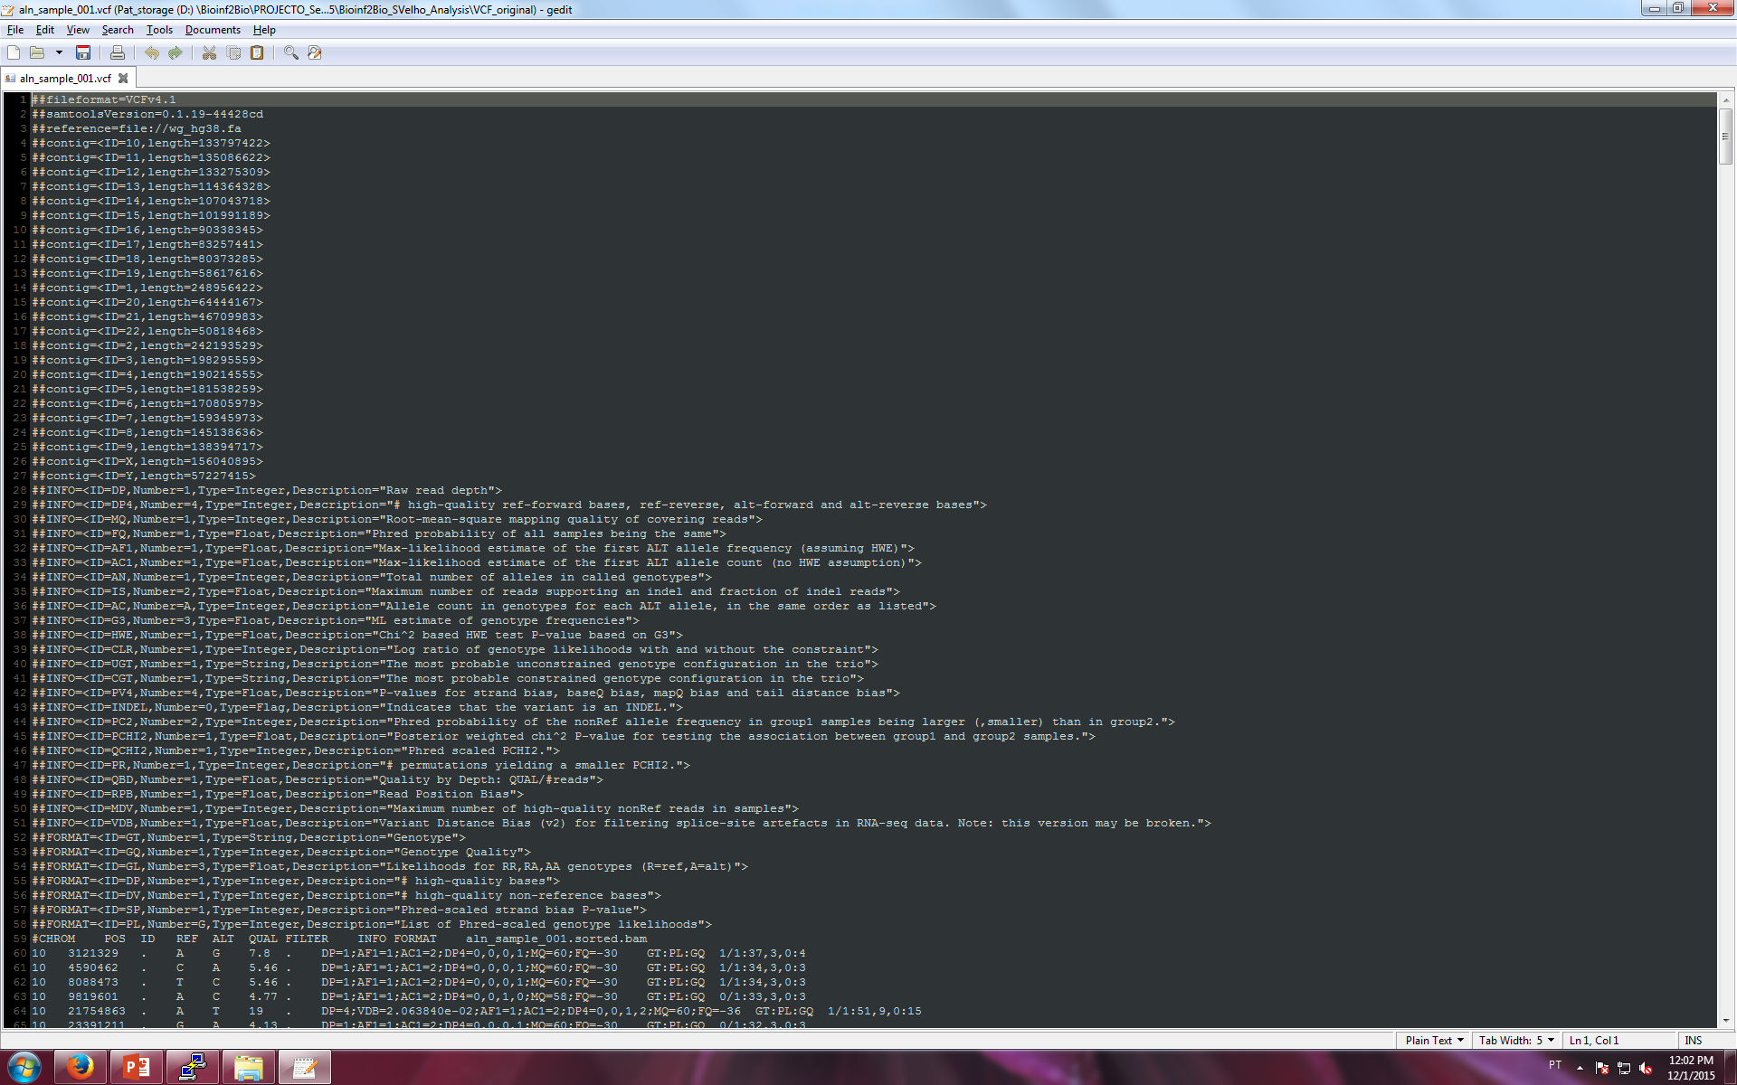
Alignment and Variant Calling (Bioinformatics Analysis)
Fastq file
reference
genome/exome
Ensembl, NCBI, UCSC download
CATTCG
CATTCG
CATTCG
TTCAACATTCGAG
Fastq file
CATTCG
Quality
Filtering
CATTCG
TATTCG
Figure adapted from Patricia Oliveira
TTCAAC
CATTCG
TATTCG
ATTCGA
TTCAAC
TATTCG
Alignment (bwa)
ATTCGA
ATTCGA
TTCAAT
ATTTGA
ATTCGA
READS
HQ READS
2. Variant calling (Samtools)
DOES NOT match
the RefSeq
4 high quality reads in
this position
4 high quality reads in
this position
Matches the
RefSeq
Variant Called!
C>T
...information encoded in the VCF file !
VCF file

Slide 39
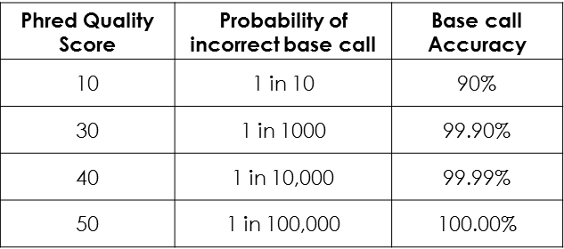
Variant Filtering based on Calling Quality
VCF file version 4.1
QUAL = Quality
Definition: Phred-scaled quality score for the assertion made for the alternative allele i.e. the probability that the call is wrong. Ranges from 1 to 225.
Example: QUAL=225, probability of error is 10^{-22.5}
High quality scores indicate high confidence calls
INFO = Information
Various information incluing depth,
allele counts, etc
DP=1;AF1=1;AC1=2;DP4=0,0,0,1; MQ=60;FQ=-30
Genotype
GT:PL:GQ 1/1:37,3,0:4
GT: Genotype (0/1, 1/1)
PL: Phred-scaled likelihood of genotype
0 is the most likely genotype
GQ: Phred-scaled quality of genotype
Ranges from 1-99
High genotype quality scores indicate
high confidence genotype calls
High confidence variant calls selected!
Adapted from Patricia Oliveira

Slide 40
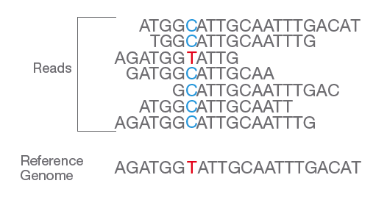
Single Nucleotide Variant detection
Adapted from Illumina.com

Slide 41
Map reads to the genome (chr21)
We will use a dataset from the 1000 Genomes Project. We will focus on the reads mapping on chr21.
Retrieve the file that contains the sequence from chr21 and the sequencing file with reads mapping on chr21 previously selected:
https://www.dropbox.com/s/jyn94xo4aokdvup/dna.tar.gz?dl=0
# Build an index for the sequence of chr 21
$ bwa index 21.fa
# align reads to reference sequence, getting genomic coordinates
$ bwa aln 21.fa HG00154.chr21.fastq.gz > HG00154.chr21.sai

Slide 42
Generate a BAM file with alignments
# create a sam file for mapped reads
$ bwa samse -f HG00154.chr21.aln.sam 21.fa HG00154.chr21.sai HG00154.chr21.fastq.gz
# convert sam to bam
$ samtools view -S HG00154.chr21.aln.sam -b > HG00154.chr21.aln.bam
# sort by genomic coordinate
$ samtools sort HG00154.chr21.aln.bam HG00154.chr21.aln.sort
# create index for the bam file
$ samtools index HG00154.chr21.aln.sort.bam
# obtain alignment statistics
$ samtools flagstat HG00154.chr21.aln.sort.bam

Slide 43
Variant calling
# Variant calling
$ samtools mpileup -uf 21.fa HG00154.chr21.aln.sort.bam | bcftools view -vcg - > HG00154.chr21.raw.vcf
# Inspecting base-level alignments
$ samtools tview HG00154.chr21.aln.sort.bam 21.fa -p 21:9417961

Slide 44
Exercises
Questions:
How many SNPs were identified in your VCF file? Create a map (plot) of mutations (reference to alternative allele, e.g C > A, G > T, etc);
ii) How many INDELs were identified in your VCF file? What are the average length of those indels;
iii) Plot the average quality of the variant calls;
iv) The allelic ratio (ar) of a variant is defined by the percentage of reads mapping on each allele: ar = #ref/ (#ref + #alt).
Plot the distribution of the allelic ratio of all variants. Hint: do a scatter plot with ar in X-axis and 1-ar in the Y-axis

Slide 45
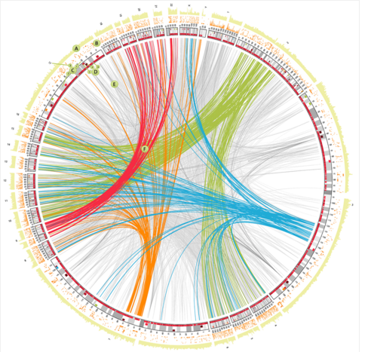
High-throughput Sequencing Assembly
This course is adapted from the Bio-Linux Tutorial and Illumina.com documentation
Algoritmos Avançados de Bioinformática

Slide 46
Fragment Assembly in DNA sequencing
Fragment assembly is the task of reconstructing the entire genomic DNA sequence.
Challenges:
- Sequencing errors
The error rate in DNA reads in current sequencing machines ranges from 1% to 3%.
- Assignment of reads to one of two strands
DNA is double-stranded, so reads can come from one of two strands
- repeats in DNA (very hard problem)
Depending on the species the genome sequence contains many repeated sequences, which can be as much as 50% of the entire genomes. Besides that it has many genes with duplicated sequences.

Slide 47
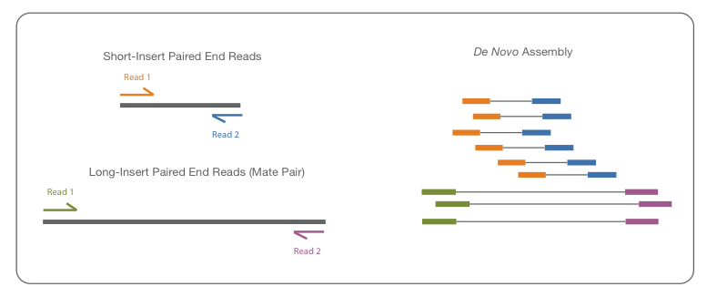
Assembly steps
Most of the fragment assembly algorithms consist of the following three steps:
1) Overlap
Finding the potential overlapping reads. Due to sequencing errors a variation of a DP algorithm for this step;
Adapted from Illumina.com

Slide 48
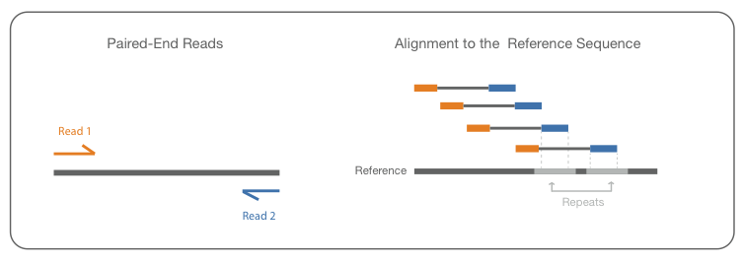
Assembly steps
Most of the fragment assembly algorithms consist of the following three steps:
2) Layout
Constructing the layout consists in deciding if reads actually overlap (and their difference is due to sequencing errors) or they originate from repeat regions (repeats make layout problem very difficult). Mate pair reads help to alleviate this problem.
Assembled
sequence
Adapted from Illumina.com

Slide 49
Assembly steps
Most of the fragment assembly algorithms consist of the following three steps:
1) Overlap
Finding the potential overlapping reads. Due to sequencing errors a variation of a DP algorithm for this step;
2) Layout
Constructing the layout consists in deciding if reads actually overlap (and their difference is due to sequencing errors) or they originate from repeat regions (repeats make layout problem very difficult). Mate pair reads help to alleviate this problem.
3) Consensus
Derive the final sequence from the layout by correcting errors in sequence reads (most frequent nucleotide in the layout given enough sequencing reads cover the region).

Slide 50
Assembly with Velvet and Abyss, QC
Very simple assembly of some reads from a mitochondrial genome.
# Prepare the data. Unzip the file.
$ cd assembly_taster
$ mkdir results
Use fastQC for QC statistics and a quick graphical overview of the dataset.
# Run FastQC on the dataset
$ fastqc -o results mt_reads.fastq
# open report.html in browser by double clicking

Slide 51
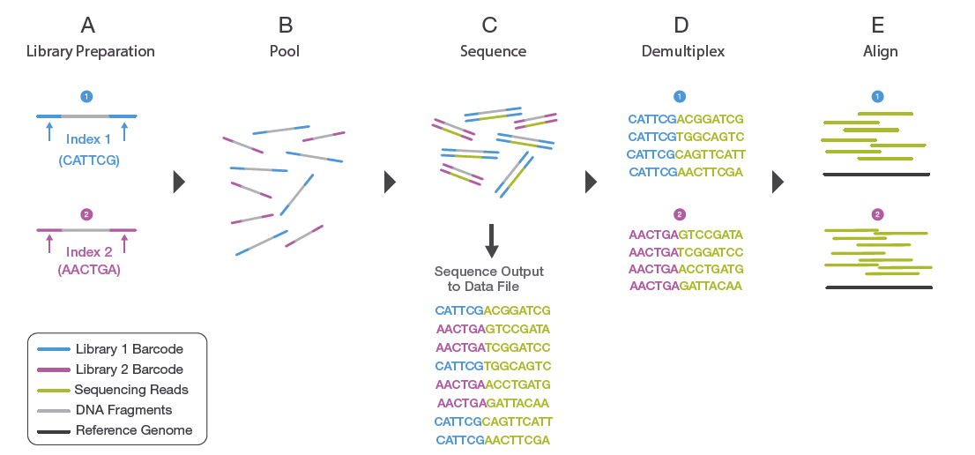
Barcoding/Multiplexing
Assembly
Adapted from Illumina.com
Multiplexing allows that more samples to be pooled and sequenced simultaneously during a single sequencing run.
This techniques reduces the cost and the time of analysis.
Notes:
a. Two distinct libraries are attached to unique index sequences. Index sequences are attached during library preparation. b. Libraries are pooled together and loaded into the same flow cell lane. c. Libraries are sequenced together during a single instrument run. All sequences are exported to a single output file. d. A demultiplexing algorithm sorts the reads into different files according to their indexes.
e. Each set of reads is aligned to the appropriate reference sequence.

Slide 52
Demultiplexing and Trimming
De-multiplexing based on the adaptor sequence:
# fastx splitter splits mt_reads.fastq by barcode.
# --bol indicates that the barcodes are at the 5’ end.
# Note the following command should be typed on a single line:
$ fastx_barcode_splitter.pl < mt_reads.fastq --bcfile mt_barcodes.txt --bol --suffix .fastq --prefix results/
Trimming removes the barcodes sequences corresponding to the multiplexing adaptor from the beginning or end of the read.
$ cd results
$ fastx_trimmer -i mt1.fastq -f 8 -o trimmed_mt1.fastq -Q33

Slide 53
Quality Filtering
Removing low quality sequences increases the accuracy of the assembly.
$ fastq_quality_filter -i trimmed_mt1.fastq -q 25 -p 80 -o qual_trim_mt1.fastq -Q33 -v
Removing artifacts from the sequencing and low quality reads will contribute to a better assembly quality.

Slide 54
Assembly with Velvet
Velvet is a highly popular short read assembler.
‘k’ == Kmer length i.e. the length of sub sequences that the data is being broken
up into, and is often one of the most important parameters to manipulate.
$ velveth velvet_k21 21 -short -fastq qual_trim_mt1.fastq
$ velvetg velvet_k21 -read_trkg -yes amos_file yes
# inspect the results with the program tablet
$ tablet velvet_k21/velvet_asm.afg &
Assembly is an iterative process of testing multiple parameters values.
VelvetOptimiser is a script which automatically tries multiple parameter combinations and returns the best assembly it can find.
$ velvetoptimiser -s 27 -e 31 -f '-short -fastq qual_trim_mt1.fastq' -a 1
$ tablet auto_data_31/velvet_asm.afg &

Slide 55
Assembly With Abyss
# Running abyss in single end mode with k=21
$ abyss -k21 qual_trim_mt1.fastq -o abyss_contigs.fa
# try abyss with multiple kmer values
$ for k in {15..20}
do
abyss -k$k qual_trim_mt1.fastq -o abyss_k$k.fa
done
# create an abyss directory and copy the resulting files

Slide 56
Assembly With Abyss
# Running abyss in single end mode with k=21
$ abyss -k21 qual_trim_mt1.fastq -o abyss_contigs.fa
# try abyss with multiple kmer values
$ for k in {15..20}
do
abyss -k$k qual_trim_mt1.fastq -o abyss_k$k.fa
done
# create an abyss directory and copy the resulting files

Slide 57
Comparing the assemblies
N50 statistic defines an assembly quality measure. Given a set of contigs, each with its own length, the N50 length is defined as the shortest sequence length at 50% of the genome. Example: 9 contigs with the lengths 2,3,4,5,6,7,8,9,and 10, their sum is 54, the size of the genome also happens to be 54. 50% of this assembly would be 2+3+4+5+6+7=27 (>25) Thus the N50=7.
Calculate the N50 statistic for each of the assemblies.
Generate a file that calculates several statistics for assessing the quality of the contigs:
- Number of contigs;
- length of the contigs;
- Average GC content;
3) Determine the best K value for each of assemblers;
4) Using the code developed in the first semester find all ORFs in the assemblies. Find the respective protein coding sequence.

Slide 58
Comparing the assemblies
Assess the impact of read quality filtering by defining a lower quality score and lower percent of bases that must have the defined quality. Specify the command line.
Evaluate the quality of the assemblies (abyss and velvet) and the impact K parameter in this quality. Use the seqstat command to extract different features of the contigs. Create a table with these results for each value of K. Make a critical comment on these results and the best value for K parameter. Including the N50 statistic is a plus for this exercise.

